Slide 1
Healthy Hybrids!
A Closer Look at Genetics in Agriculture

Slide 2
Learning Intentions
01
Hybrids & Genetics
02
Gregor Mendel
03
Laws of Dominance
04
Punnett Squares

Slide 3
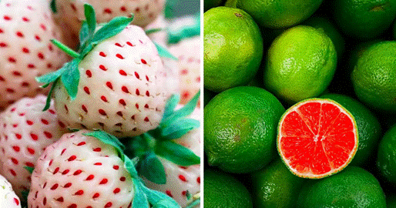
Hybrids
In plants, hybrids are produced by cross-pollination resulting in some looking bizarre fruits
This is done by transferring the pollen from the flower of one plant to the stigma of another
Basic Genetics
Photo Unknown, CC BY 4.0 https://creativecommons.org/licenses/by/4.0

Slide 4
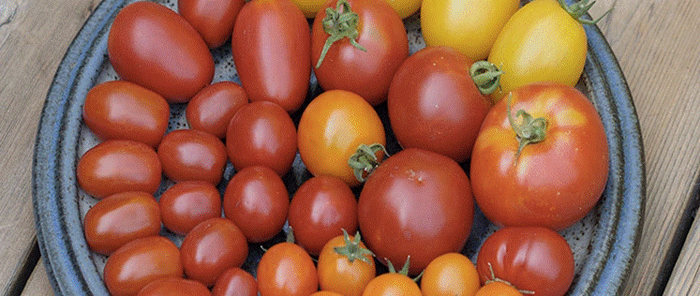
Natural Occurring Hybrids
Sometimes plants hybridize naturally when their geographical locations overlap
This may result in multiple varieties of plants
Basic Genetics
Photo Unknown, CC BY 4.0 https://creativecommons.org/licenses/by/4.0

Slide 5
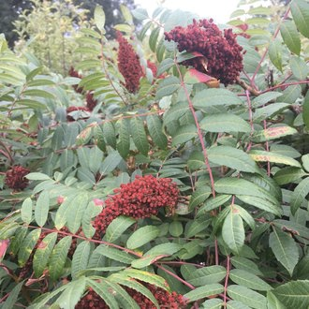
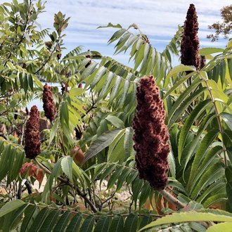
Natural Occurring Hybrids
First Nations tribes have been using plant hybrids for centuries for food and medicinal purposes
Hybrids of Smooth Sumac (Rhus glabra) and Staghorn Sumac (R. typhina) used by peeling and eating the roots and eating the fruits, fresh or dried
Basic Genetics
Photo © Alaina Larkin, https://creativecommons.org/licenses/by/4.0
Photo © Ryan Kurtz, https://creativecommons.org/licenses/by/4.0

Slide 6
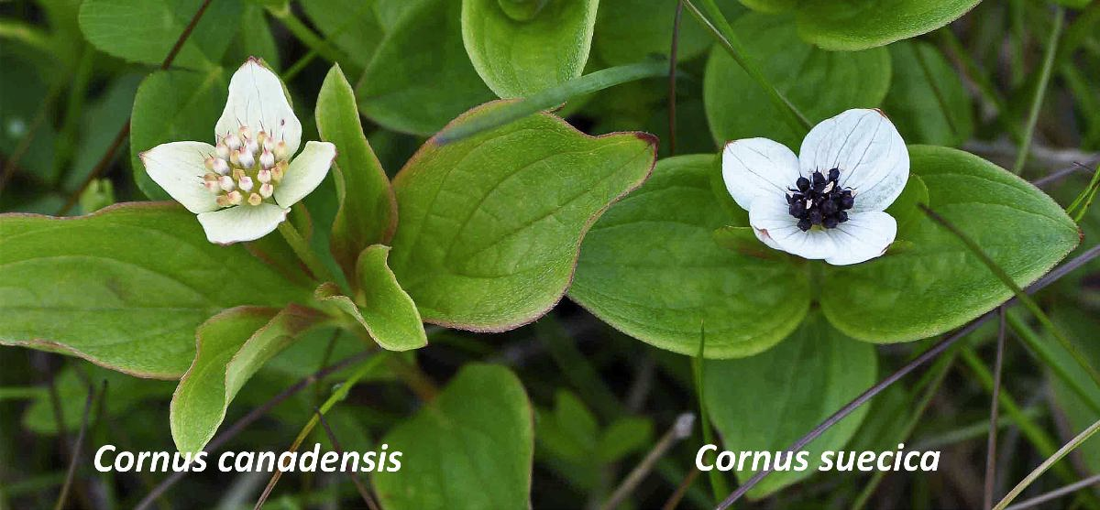
Natural Occurring Hybrids
Hybrids of Canadian Bunchberry (Cornus Canadensis) and its closely related the Dwarf Dogwood (C.suecica) were frequently used as food by the coastal First Peoples of British Columbia
Kuhlein, H & Turner, N. (1991) Traditional Plant Foods of Canadian Indigenous Peoples: Nutrition,
Botany and Use. Retrieved from: http://www.fao.org/3/a-ai215e.pdf
Basic Genetics
Photo Unknown, CC BY 4.0 https://creativecommons.org/licenses/by/4.0

Slide 7
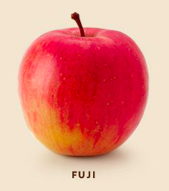
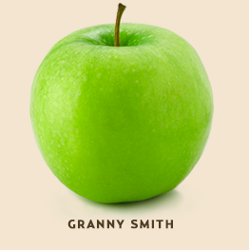
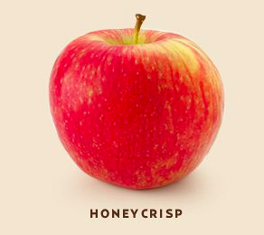
BC Hybrids
In British Columbia, we grow a large number of naturally occurring hybrids.
The Fuji apple is a hybrid cross between a Red Delicious and the Virginia Ralls Janet apple
The Honeycrisp apple is a cross between Macoun and Honey Gold, Honeycrisps
The Grannysmith apple is thought to be a hybrid of the European Wild Apple and a domestic apple.
Basic Genetics
Photos: www.bctreefruits.com

Slide 8
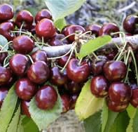
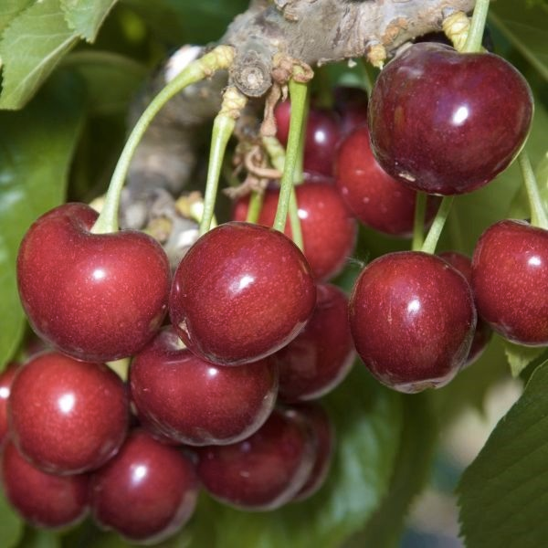
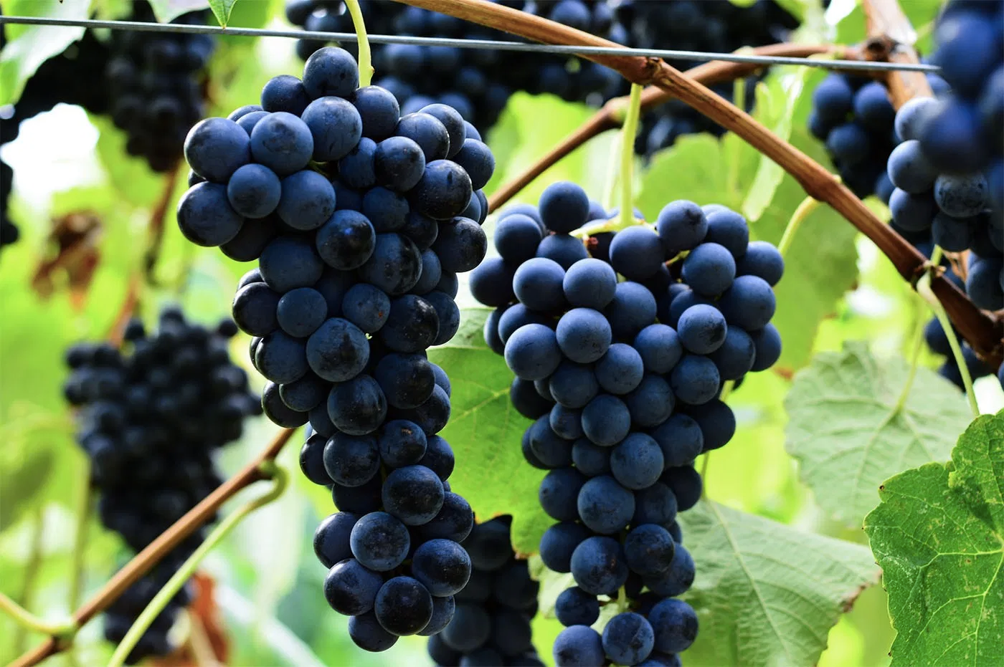
BC Cultivars
A cultivar is a plant variety that has been produced by selective breeding
In British Columbia, some unique cultivars have been bred at the Pacific Agri-Food Research Centre in Summerland, BC including:
Apples:
Spartan
Aurora Golden Gala
Jubilee
Nicola
Grapes:
Coronation
Cherries
Skeena
Lapins
Stella cherry
Sweetheart
Basic Genetics
Photo Unknown, CC BY 4.0 https://creativecommons.org/licenses/by/4.0

Slide 9
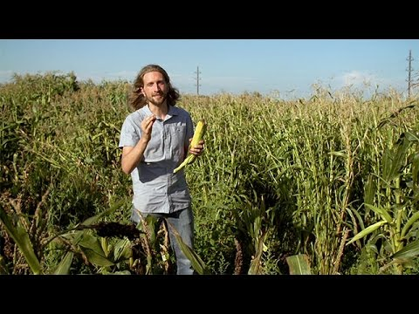
The History of Modern Corn
Basic Genetics
Click above image to watch video or visit https://www.youtube.com/watch?v=mBuYUb_mFXA

Slide 10
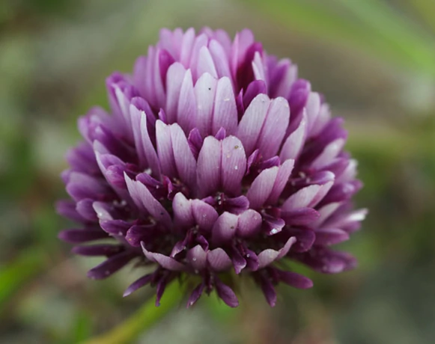
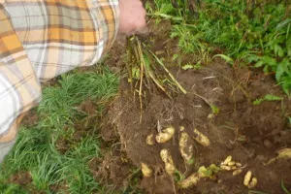
Early Cultivation in BC
Early ownership and stewardship of land by Indigenous families and tribes was common in BC
Some Nuxalk people of Bella Coola would annually plant spring bank clover on the river floodplains
The Haida of Haida Gwaii, for example, who were already experienced became renowned for their expertise in potato production.
© Nevit Dilmen, CC BY-SA 3.0, via Wikimedia Commons
Basic Genetics
Photo cred: https://www.bcfoodhistory.ca/haida-potatoes

Slide 11
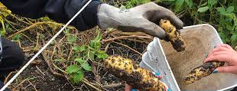
Haida Potatoes in BC
The Haida potato called Xaadas sgúusadaa, in the Haida language meaning “long and skinny”
It also is “knobby” and resembles a finger, therefore often thought to be a fingerling variety.
The Haida potato has yellowish skin and white flesh. It apparently is a “prolific producer” well suited to the damp, cool conditions of the north coast of BC and Haida Gwaii.
Potato saving is a tradition and has saved the Haida potato from extinction since there is no source of seed potatoes.
Plant foods, such as fruits and vegetables, were a common item of exchange in the traditional economies of Indigenous Peoples.
Basic Genetics
Photo credit: https://www.bcfoodhistory.ca/haida-potatoes

Slide 12
HEREDITY
Heredity is the passage of genetic traits from one generation to the next
It is controlled by the chromosomes in the nucleus of the cell
GENETICS
HEREDITY
GENETICS
Genetics is the science of heredity

Slide 13
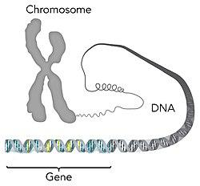
Chromosomes
Chromosomes are composed of small units called genes (DNA)
Genes carry the hereditary information and are found at specific locations along the chromosomes
Humans have 23 pairs (total = 46) of chromosomes
Basic Genetics
Photo Unknown, CC BY 4.0 https://creativecommons.org/licenses/by/4.0

Slide 14
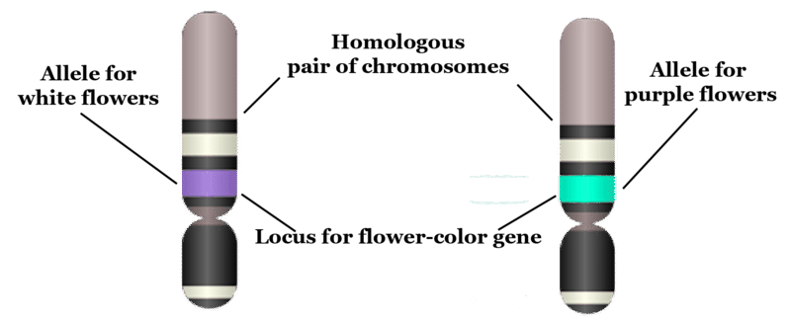
Alleles
Alleles are pairs of genes that carry the same traits (Loci) and are located on the same places on pairs of chromosomes
The allele describes specifically what the trait is
Examples include:
Blue eye color
Curly hair
Short stature
Basic Genetics
Photo Unknown, CC BY 4.0 https://creativecommons.org/licenses/by/4.0

Slide 15
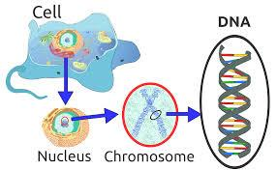
Genotype vs. Phenotype
Genotype: the genetic makeup of an individual
Phenotype: the physical appearance of an organism
Basic Genetics
Photo Unknown, CC BY 4.0 https://creativecommons.org/licenses/by/4.0

Slide 16
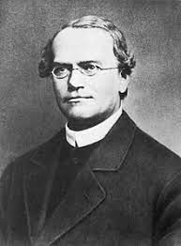
Gregor Mendel
Gregor Mendel was considered the “father of genetics”
He conducted controlled heredity experiments using common garden pea plants
His work was the first major study into the science of heredity
Basic Genetics
“File:Gregor Mendel oval.jpg" by Hugo Iltis is licensed under CC BY 4.0

Slide 17
Gregor Mendel
Through breeding pea plants, Mendel derived the following laws about genetics:
Law of Dominance
Law of Segregation
Law of Independent Assortment
Basic Genetics

Slide 18
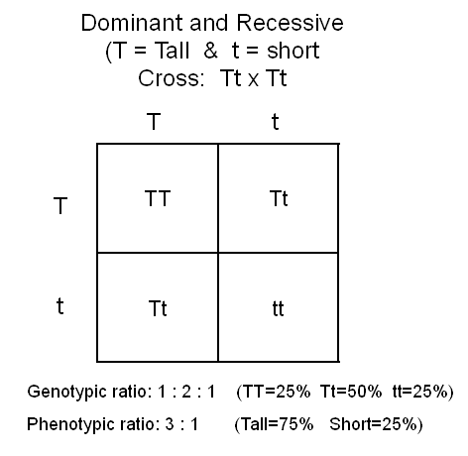
Law of Dominance
A heterozygous individual has 2 different alleles
The one that appears in the offspring is the dominant allele
The one that does not appear in the offspring is the recessive allele
Basic Genetics
Photo Unknown, CC BY 4.0 https://creativecommons.org/licenses/by/4.0

Slide 19
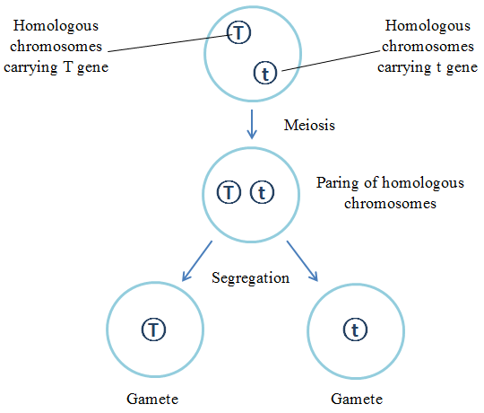
Law of Segregation
During sexual reproduction, traits from both parents recombine randomly during fertilization which results in recombination
Basic Genetics
Photo Unknown, CC BY 4.0 https://creativecommons.org/licenses/by/4.0

Slide 20
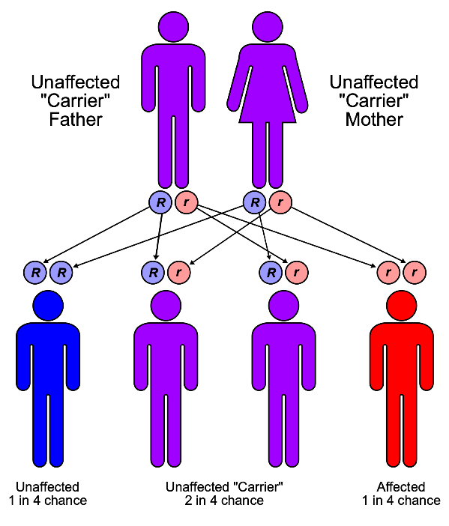
Law of Independent Assortment
Allele pairs separate independently during the formation of egg and sperm cells (gametes)
This means that traits are transmitted to offspring independently
Basic Genetics
Photo Unknown, CC BY 4.0 https://creativecommons.org/licenses/by/4.0

Slide 21
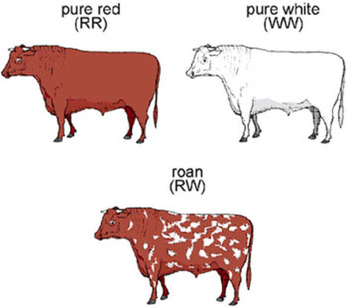
Co-dominance
Codominance is when both alleles are expressed in the heterozygote
Basic Genetics
Photo Unknown, CC BY 4.0 https://creativecommons.org/licenses/by/4.0

Slide 22
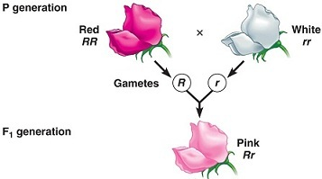
Incomplete Dominance
Allele pairs separate independently during the formation of egg and sperm cells (gametes)
This means that traits are transmitted to offspring independently
Basic Genetics
Photo Unknown, CC BY 4.0 https://creativecommons.org/licenses/by/4.0

Slide 23
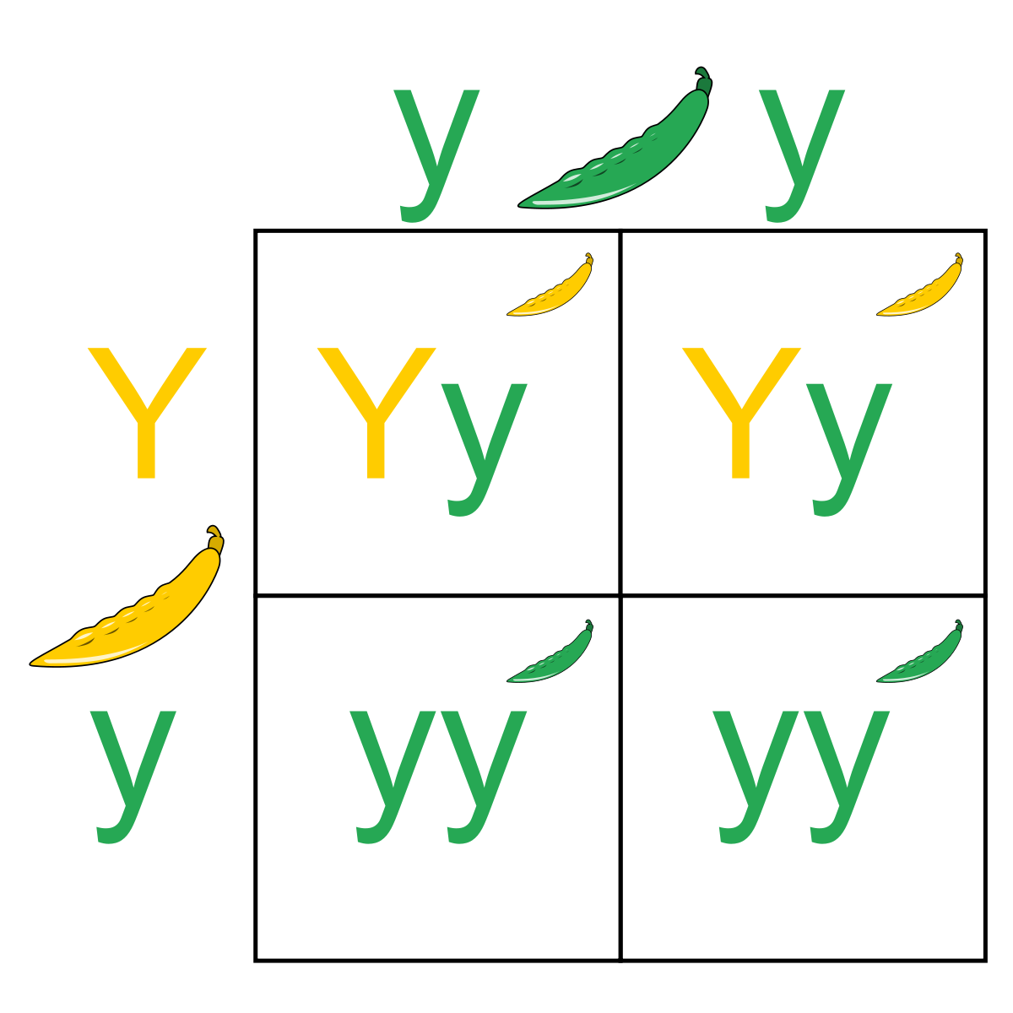
Punnett Squares
Mendel developed the law of segregation by following only a single characteristic, such as pod color, in his pea plants.
Biologists use a diagram, now called a Punnett square, to help predict the probable inheritance of alleles in different crosses.
Basic Genetics
Photo Unknown, CC BY 4.0 https://creativecommons.org/licenses/by/4.0

Slide 24
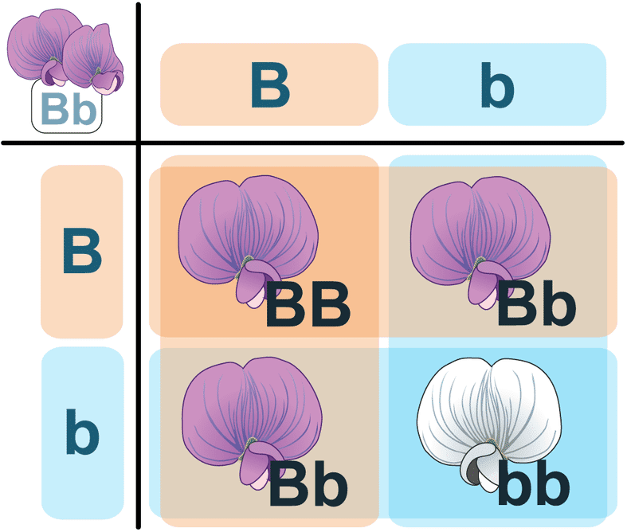
Punnett Squares
A Punnett square shows every possible combination when combining one maternal (mother) allele with one paternal (father) allele.
In this example, both organisms are heterozygous for flower color Bb (purple).
The probability of any single offspring showing the recessive trait (genotype = bb; phenotype = white) is 25%.
Basic Genetics

Slide 25
Presentation By: Sabrina Bhojani, Education Specialist 2020-2021, BCAITC

